Slide 1





ECET 12: TEAM 09
Senior Project
Abhishek Hariharan and Jonathan Wong

Slide 2
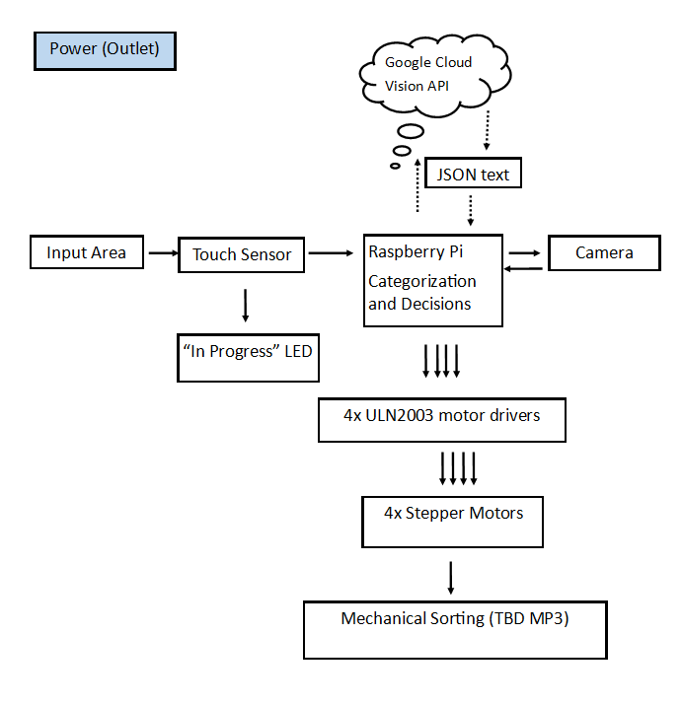
MP2 Updated Block Diagram
This is less “skimpy”

Slide 3
Hardware Deliverable Commitment as per Contract | Actual Deliverable
Interface Raspberry Pi (RPi) w/ RPi Camera | ✓
Interface RPi with force-sensitive resistor (FSR) | ✓
Interface RPi with stepper motors using any necessary motor drivers | ✓ (using ULN2003 drivers)
Plastic container to cover hardware & mimic darkness, camera in box | Discussed with instructor, design change approved for no cost to points (camera on box, most hardware out)
LED to indicate when object is correctly placed on the sensor (FSR) | ✓
Software Deliverable Commitment as per Contract | Actual Deliverable
Interface to the Google Cloud Vision API (software connection to WiFi) | ✓
Code that categorizes the recyclable object using the image taken and stepper motors accordingly | ✓
Code that lights up LED when object is correctly placed on the sensor | ✓

Slide 4
Demo Details
Program will be started after set up is complete.
Object place inside IRS container incorrectly (will show @ demo), LED does not turn on
For each type of object in no particular order, place onto the pressure sensor such that the LED turns on.
LED on will indicate that the object is being processed. The next input is ready to be processed once LED turns off.
Picture of object is taken.
Object recognition results determined, speed depends upon the quality of WiFi/hotspot
If object is “rejected item” or if the connection to the server is not successful, another picture/request will be submitted
Corresponding stepper motor will spin.
LED will turn off in a few seconds after motor stops spinning (approx 5 seconds) .
Repeat starting from step 2 with different objects as necessary.

